Slide 1

AN ADVANCED MODULATION TECHNIQUE FOR CASCADED MULTILEVEL INVERTER OF HIGHER VOLTAGE LEVEL AND LOWER TOTAL HARMONIC DISTORTION
Project Associates:
S.KAVYASREE (10F01A02A8)
M.NANCHARAIAH (10F01A0277)
K.AYYAPPA SWAMI (11F05A0211)
CH.NAGABHUSHANAM (11F05A0203)
Under the guidance of
Mr. G.KALADHAR M.Tech,(Ph.d)
ASSISTANT PROFESSOR
DEPARTMENT OF ELECTRICAL & ELECTRONICS ENGINEERING

Slide 2
ABSTRACT
This project proposes a some new multilevel inverter topologies to reduce the low order harmonics and total harmonic distortion(THD). A new topology of multilevel inverter is presented which has the number of output voltage levels due to number of cells which is made it is so operational.

Slide 3
Outline of the presentation:-
Introduction
Multilevel Inverters
Block Diagrams of Multilevel Inverters
Simulation Diagrams & outputs
Table for comparison of Multilevel Inverters
Conclusion

Slide 4
Introduction
Inverters are very popular power electronic devices which are widely used in adjustable speed motor drivers, power supplies and photovoltaic cells.
The inverter sinusoidal output waveform causes the output harmonics to be optimized.
A new structure of multilevel inverter is presented which significantly increases the number of output voltage levels for the same number of stages which is reduced the low order harmonics and also the total harmonic distortion (THD).

Slide 5
MULTILEVEL INVERTERS
Cascaded H-Bridge
Incremental cascade H-Bridge
Incremental cascade I-Bridge
Incremental-reduction cascade H-Bridge
Combined cell cascade

Slide 6
Block Diagrams of Multilevel Inverters

Slide 7
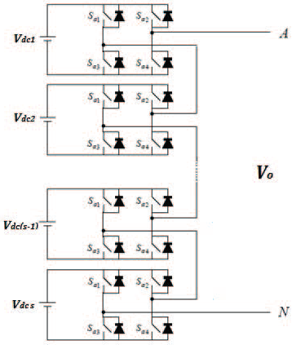
Cascaded H-Bridge Multilevel Inverter

Slide 8
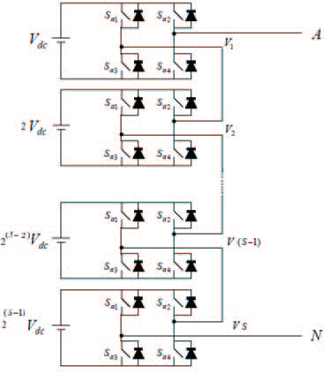
Incremental cascade H-Bridge Multilevel Inverter

Slide 9
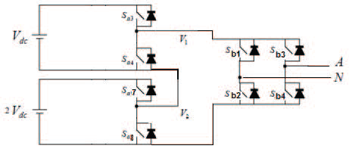
Incremental cascade I-Bridge Multilevel Inverter

Slide 10
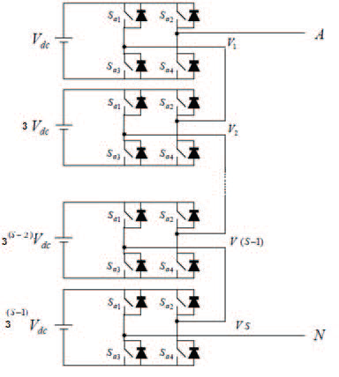
Incremental-reduction cascade H-Bridge Multilevel Inverter
The equivalent circuit of PV cells

Slide 11
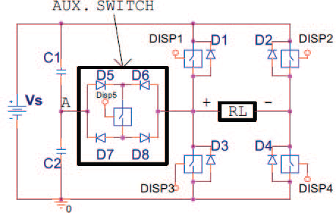
Combined cell cascade Multilevel Inverter

Slide 12
Simulation Diagrams & Outputs

Slide 13
Simulation diagram for Cascade H-Bridge Multilevel Inverter
Continuous
powergui
Repeating
g
C
g
C
D2
Sequence
DC1
a
m
m
s1
s4
k
k
a
D1
m
E
Repeating
m
E
Sequence2
g
C
R
+
v
-
Scope
Repeating
s5
Voltage Measurement
Sequence4
m
E
D3
Repeating
m
a
a
m
Sequence3
k
k
g
C
DC2
D4
g
C
s3
Repeating
m
E
s2
Sequence1
m
E

Slide 14
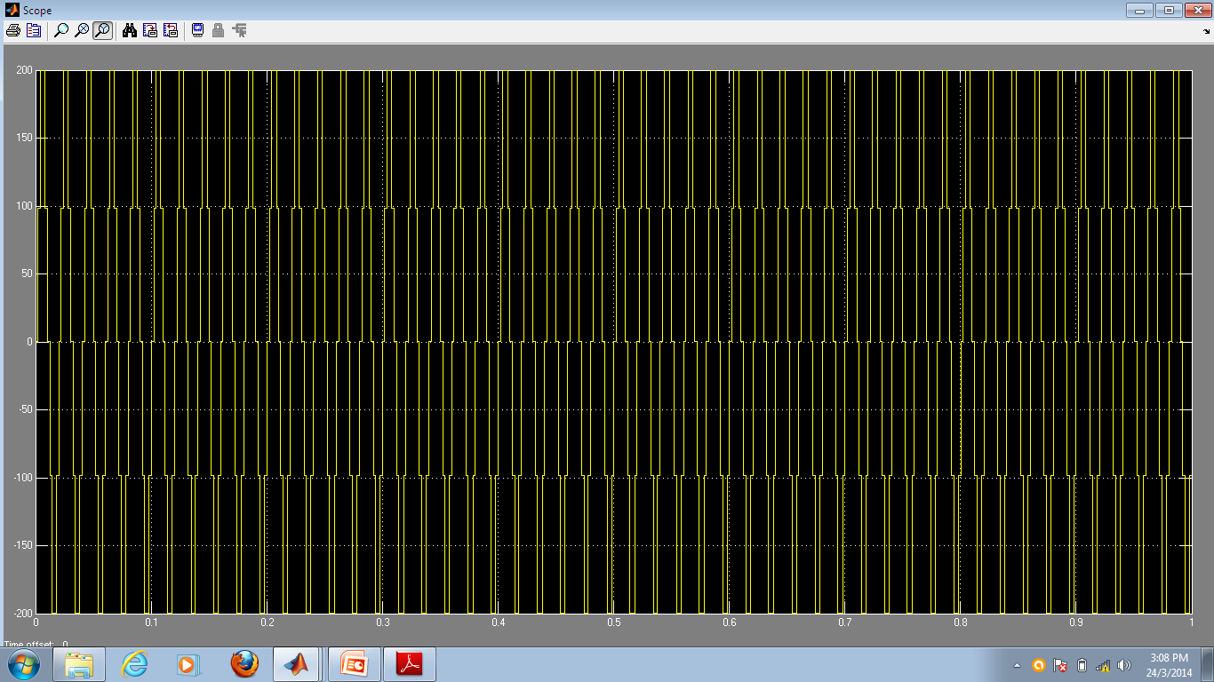
Output waveforms for cascaded H-Bridge Inverter

Slide 15
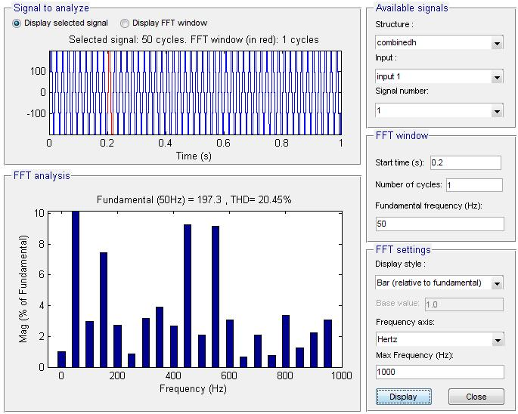

Slide 16
Simulation diagram for Incremental cascade H-Bridge Multilevel Inverter
g
C
g
C
IGBT/Diode
IGBT/Diode3
Repeating
Repeating
Sequence
m
E
Sequence2
m
E
Discrete,
Ts = 5e-005 s.
Logical
powergui
Operator
Logical
DC Voltage Source
NOT
Operator1
g
C
NOT
g
C
IGBT/Diode2
m
E
IGBT/Diode1
m
E
+
v
SR
-
Voltage Measurement
Scope
g
C
g
C
IGBT/Diode5
Repeating
IGBT/Diode4
Repeating
m
E
Sequence3
m
E
Sequence1
Logical
Operator3
Logical
DC Voltage Source1
NOT
Operator2
g
C
NOT
g
C
IGBT/Diode7
m
E
IGBT/Diode6
m
E

Slide 17
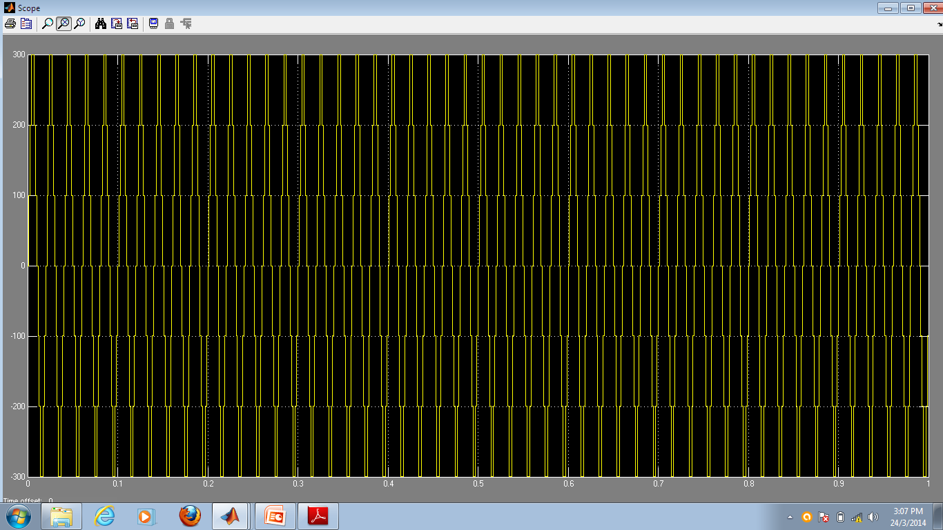
Output waveform for incremental cascade H-Bridge Inverter

Slide 18
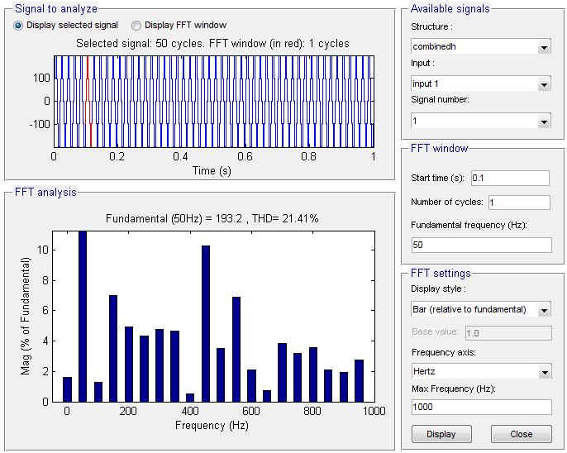

Slide 19
Simulation diagram for Incremental cascade I-Bridge Multilevel Inverter

Slide 20
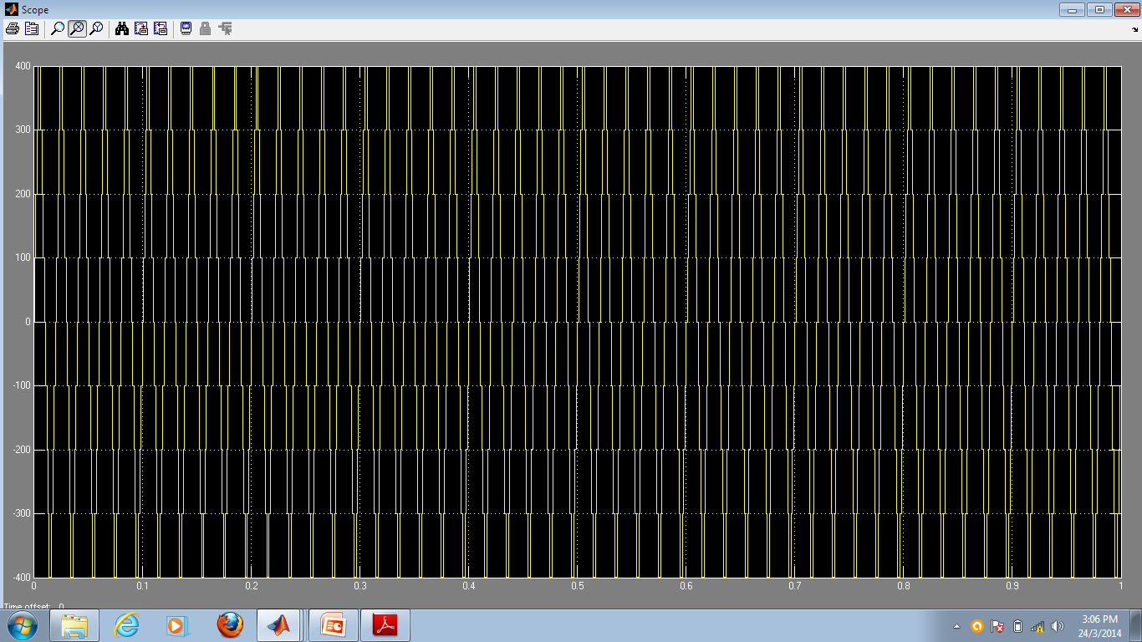
Output waveform for incremental cascade I-Bridge Inverter

Slide 21
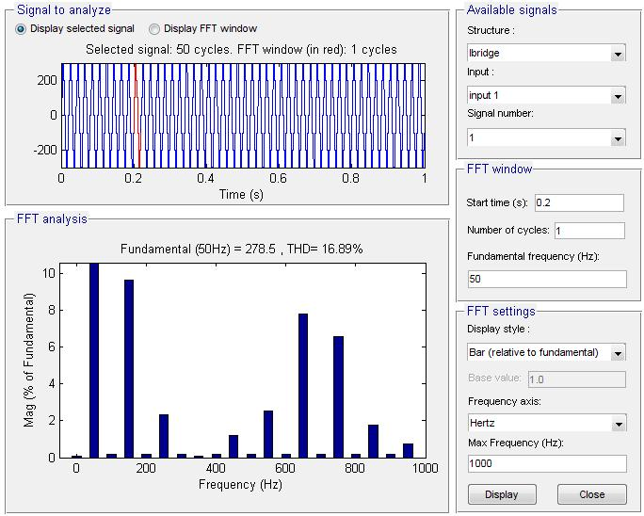

Slide 22
Simulation diagram for Incremental reduction cascade H-Bridge Multilevel Inverter
g
C
Repeating
IGBT/Diode4
m
E
Sequence1
Discrete,
g
C
g
C
Ts = 5e-005 s.
IGBT/Diode
IGBT/Diode3
powergui
Repeating
Repeating
DC Voltage Source
Logical
Sequence
m
E
Sequence2
m
E
Operator2
NOT
g
C
IGBT/Diode5
m
E
Logical
Logical
Operator
Operator1
SR
+
v
NOT
NOT
-
Scope
Voltage Measurement
g
C
IGBT/Diode6
g
C
g
C
Repeating
m
E
IGBT/Diode2
IGBT/Diode1
Sequence3
m
E
m
E
Logical
Operator3
DC Volt
NOT
g
C
IGBT/Diode7
m
E

Slide 23

Output waveform for Incremental reduction cascade H-Bridge Inverter

Slide 24
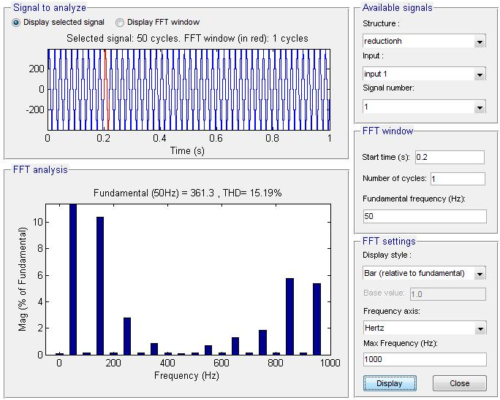

Slide 25
Simulation diagram for Combined cell cascade Multilevel Inverter
g
C
g
C
IGBT/Diode
IGBT/Diode3
Repeating
Repeating
Sequence
m
E
Sequence2
m
E
Discrete,
Ts = 5e-005 s.
Logical
powergui
Operator
Logical
DC Voltage Source
NOT
Operator1
g
C
NOT
g
C
IGBT/Diode2
IGBT/Diode1
m
E
m
E
+
v
R
-
Voltage Measurement
Scope
g
C
g
C
IGBT/Diode5
Repeating
IGBT/Diode4
Repeating
m
E
Sequence3
m
E
Sequence1
Logical
Operator3
Logical
DC Voltage Source1
NOT
Operator2
g
C
NOT
g
C
IGBT/Diode7
IGBT/Diode6
m
E
m
E

Slide 26
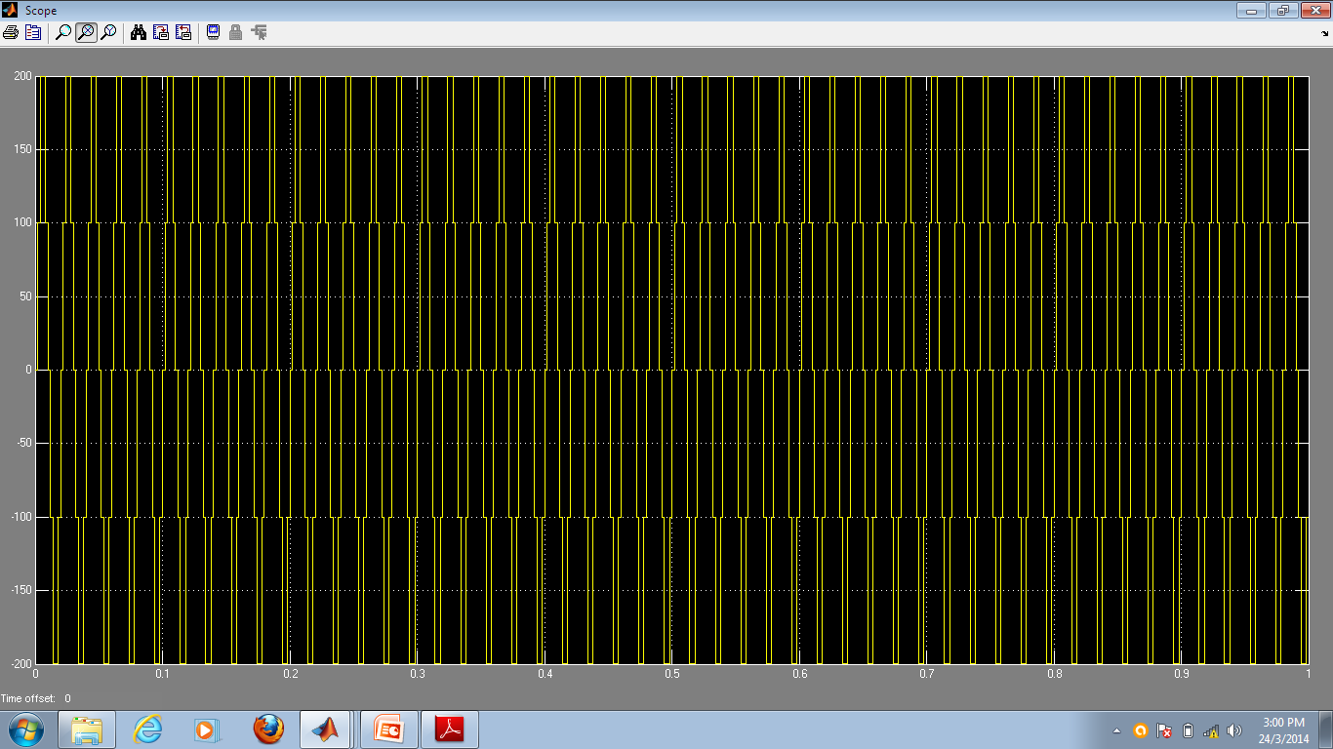
Output waveform for combined cell cascade inverter

Slide 27


Slide 28
Table for comparison of Five Multilevel Inverters
Topology | Levels number | THD | Switch number | Separated DC source
Cascade H-bridge | 5 | 20.45% | 8 | 2
Incremental cascade H-bridge | 7 | 21.42% | 8 | 2
Incremental cascade I-bridge | 7 | 16.89% | 8 | 2
Incremental reduction cascade H-bridge | 9 | 15.19% | 8 | 2
Combined cell cascade | 25 | 20.45% | 10 | 2

Slide 29
CONCLUSION
The multilevel inverters were simulated in MATLAB and the comparison results proved that the combined cascade multilevel inverter had the highest number of output voltage levels due to the number of cells in cascade.
Increasing the number of output voltage levels reduces the lower order harmonics and the THD.
In the incremental cascade H-bridge in which higher Dclink voltage has lower switching frequency, the number of switching devices and as a result the switching losses are reduced.

Slide 30
THANK YOU

